Slide 1
STAT 7900: Special Topic:
Causal Analysis
Instructor
Dhrubajyoti Ghosh
KENNESAW STATE UNIVERSITY
STAT 7900

Slide 2
Introduce yourself.
Your program and year
One thing you hope to learn from this course

Slide 3
Class Structure: In-person and online
Exams: 1 midterm and 1 final project.
Assignments: 3 over the semester
Quizzes: Daily quizzes on previous class content.

Slide 4
Causal Analysis
Examples of causal questions:
Medicine
Would a new treatment reduce mortality?
Education
Would reducing a class size improve achievement?
Policy
Would raising a minimum wage affect employment?
Public Health
Would reducing air pollution lower asthma admissions?

Slide 5
What is Causal Inference
Learning the effect of a treatment, exposure, policy, or intervention on an outcome.
Treatment
Outcome

Slide 6
Three Kinds of questions
Descriptive
What is happening?
Example: How does blood pressure differ between smokers and non-smokers?
Predictive
What will happen?
Example: Can age, BMI or smoking predict future blood pressure?
Causal
What would happen if we intervened?
Example: Would smoking cessation lower blood pressure?

Slide 7
Three Kinds of questions
We can have same dataset but different questions.
Imagine a cohort with diet, age, BMI, blood pressure, and future cardiovascular events.
Describe: What is the average sodium intake?
Predict: Who will develop hypertension?
Cause: What would happen to blood pressure if sodium intake were reduced?
The scientific question determines the analysis.

Slide 8
Simpson’s Paradox
New disease: COVID-27.
Treatment T: A (0), B (1).
You need to decide which treatment to use for the country.
Condition C: mild (0), severe (1)
Outcome Y: alive (0), dead (1)

Slide 9
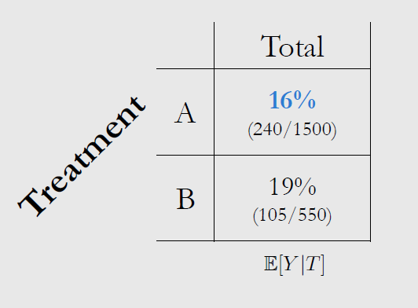
Simpson’s Paradox: Mortality Rate Table

Slide 10
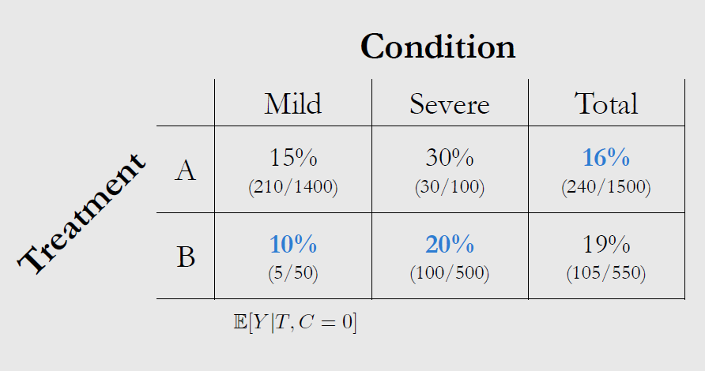
Simpson’s Paradox: Mortality Rate Table
$$\frac{1400}{1500} \left(0.15\right)+\frac{100}{1500} \left(0.30\right)=0.16 ; \frac{50}{550}\left(0.10\right)+\frac{500}{550} \left(0.20\right)=0.19$$

Slide 11
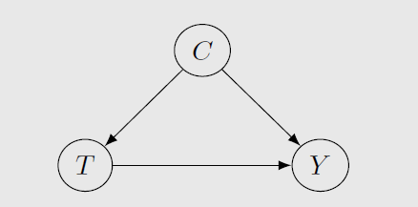
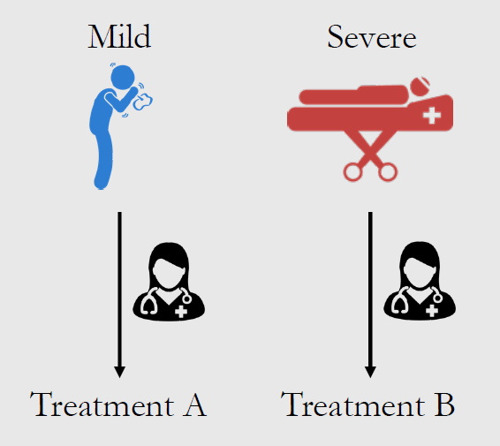
Simpson’s Paradox: Which treatment is better?
Treatment B is better

Slide 12
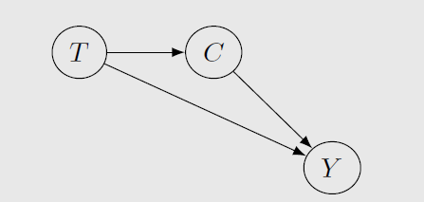
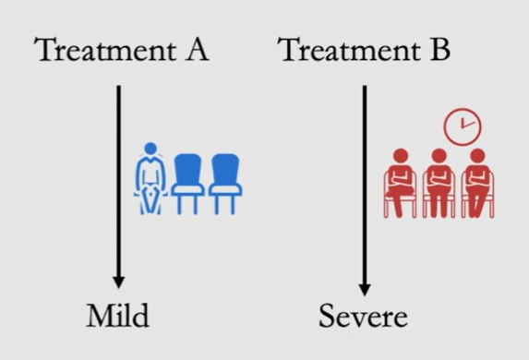
Simpson’s Paradox: Which treatment is better?
Treatment A is better

Slide 13
Simpson’s Paradox: A Real dataset example
R includes the classic 1973 Berkeley graduate admissions table as UCBAdmissions.
4526 Applicants
6 Departments
2 gender categories
2 Admission Outcomes
Question: Were female applicants less likely to be admitted?

Slide 14

Simpson’s Paradox: A Real dataset example
Overall Admissions Rate:
Male applicants: $44.5\%$ (1198 admitted out of 2691 applicants)
Female applicants: 30.4% (557 admitted out of 1835 applicants)
What would you conclude?
Does 44.5% vs 30.4% show that being female reduced the chance of admission?

Slide 15
Simpson’s Paradox: A Real dataset example
A hidden structure: Department
Applicants did not apply to the same department in the same proportions.
Departments also have different selectivity.
Department
Admission
Gender

Slide 16
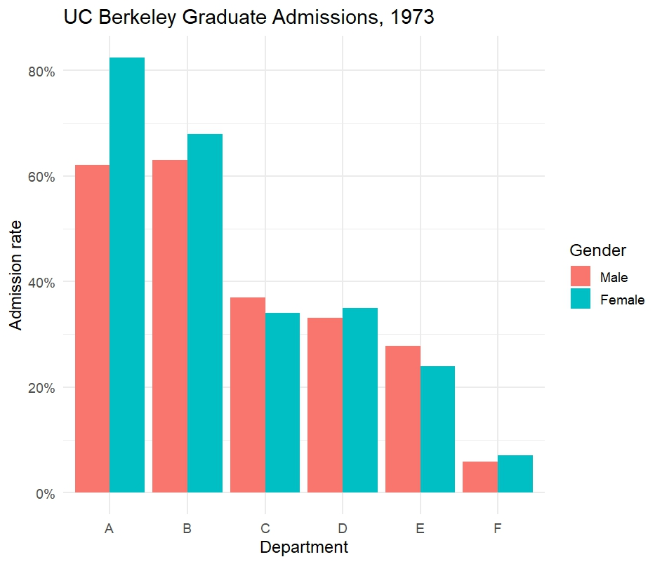
Simpson’s Paradox: A Real dataset example

Slide 17
Simpson’s Paradox: A Real dataset example
The aggregate comparison and the within group comparisons can point in different directions.
Overall: Male 44.5%, Female 30.4%
When we consider within departments, the gap shrinks or reverses in several departments.
Departments had very different admission rates.
Male and female applicants applied to those departments in different proportions.
The overall rate is a weighted average of department-specific rates.
Changing the weights can change the apparent association.

Slide 18
Correlation and Causation
Correlation does not imply causation.
Example 1: Sleeping with shoes on is strongly correlated with waking up with a headache.
Common Cause: Drinking the night before.
Shoe-sleepers differ from non-shoe sleepers in a key way.
This is called Confounding.
Total association (e.g. Correlation): Mixture of causal and confounding association.
“Correlation = Causation” is a cognitive bias.

Slide 19
Correlation and Causation
Different types of cognitive bias:
Availability heuristic
Motivated Reasoning
Anchoring bias
Confirmation bias
Apophenia

Slide 20
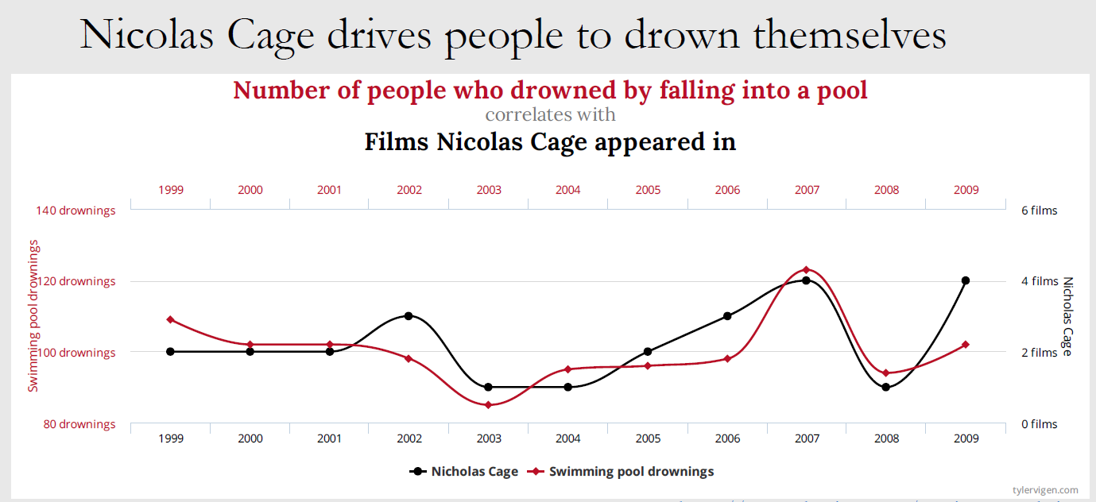
Correlation and Causation

Slide 21

Prediction and Causation
Prediction and Causation answer two different questions.
Prediction: $P\left(Y \right| X).$
Causation: $E (Y\left(1\right)−Y(0))$.
Suppose an electronic health record contains age, diagnosis, labs, treatment, and mortality.
Prediction: Which patients are most likely to die?
Causation: Would giving treatment A reduce mortality?
Treatment itself may be a strong predictor because the sickest patients receive it.

Slide 22
Prediction and Causation
High predictive accuracy does not establish a causal effect.
A model can perfectly learn patterns that are consequences of confounding, selection mechanisms, treatment decisions, post-treatment variables, etc.
Prediction asks whether the pattern repeats.
Causal inference asks what would change under intervention.

Slide 23
Formulating a causal question
Can I meaningfully imaging changing the exposure?
Association: Are smokers less healthy?
Causal: What would happen to health if smokers stopped smoking?
Association: Are highly educated people wealthier?
Causal: What would earnings be if a person received one additional year of education?
Association: Do people who exercise more have lower blood pressure?
Causal: What would happen to blood pressure if sedentary adults increased their exercise by 150 minutes per week?
Association: Are people who drink coffee less likely to develop Parkinson’s disease?
Causal: What would happen to Parkinson’s disease risk if people increased their coffee consumption?

Slide 24
Formulating a causal question
Five ingredients of a causal question
1
Population
Who?
2
Treatment
What intervention?
3
Comparator
Compared with what?
4
Outcome
What endpoint?
5
Time
Over what horizon?

Slide 25
Formulating a causal question
Does tutoring help students?
Among students eligible for tutoring, what would be the difference in pass rates if all were assigned tutoring versus if none were assigned tutoring?

Slide 26
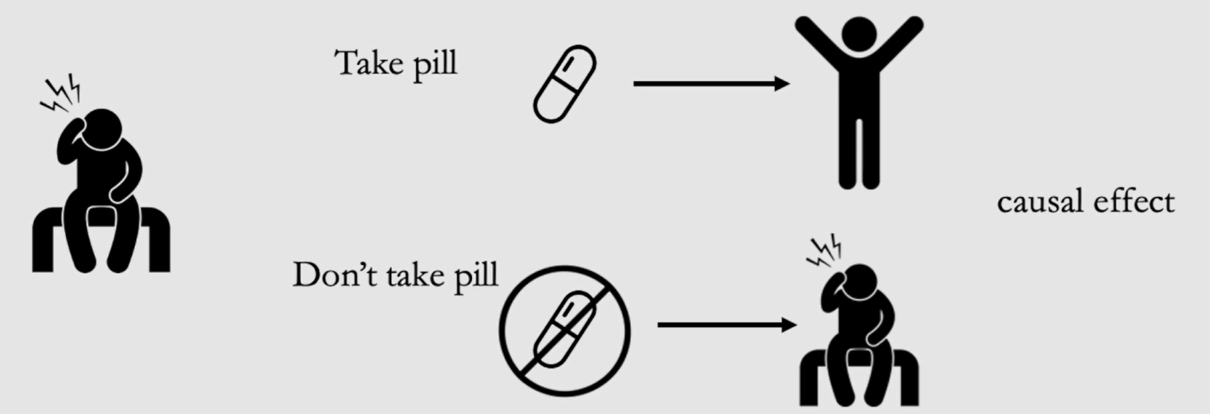
What implies causation?

Slide 27
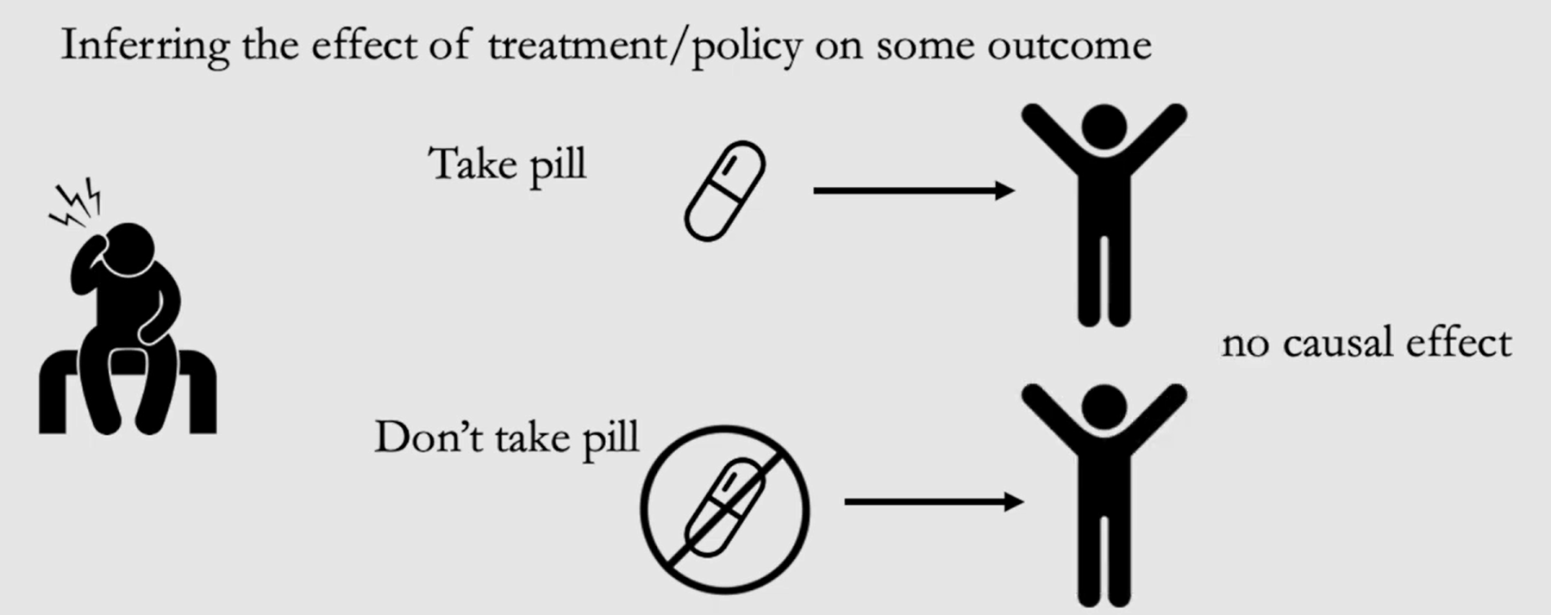
What implies causation?

Slide 28

Potential Outcomes
Suppose T is the treatment (=1 means treated, =0 means not treated).
Y: Observed outcomes, $i$ is used in subscript to denote a specific unit/ individual.
Take the pill: $do(T=1)$, Outcome: $Y_{i|do(T=1)}≡Y_{i}(1)$
Do not take the pill: $do(T=0)$, Outcome: $Y_{i|do(T=0)}≡Y_{i}(0)$
$Y_{i}(1)$ is $potential outcome$ under treatment.
$Y_{i}(0)$ is $potential outcome$ under no treatment.
Causal Effect: $Y_{i}\left(1\right)−Y_{i}(0)$

Slide 29
Potential Outcomes
World 1
Treatment Received
A = 1
Outcome: Y(1)
World 2
No treatment
A = 0
Outcome: Y(0)

Slide 30

Potential Outcomes: Fundamental Problem
You cannot observe both $Y_{i}(1)$ and $Y_{i}(0)$ at the same time.
You cannot be given treatment and not given treatment at the same time.
Example: If you are given treatment, you can only observe $Y_{i}(1)$.
$Y_{i}(0)$ cannot be observed, and this is called counterfactual.
If A=1, observed Y(1). Then Y(0) is counterfactual.
If A=0, observed Y(0). Then Y(1) is counterfactual.
Causal inference is the science of learning about those missing counterfactuals.

Slide 31
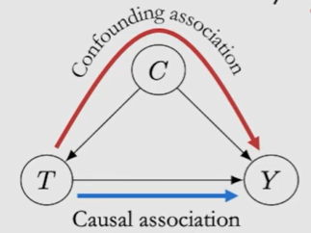

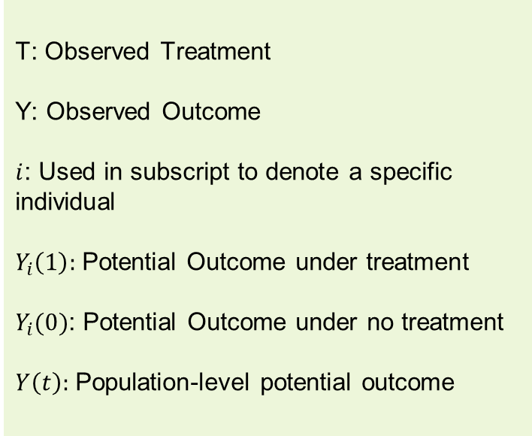
Average Treatment Effect
T: Observed Treatment
Y: Observed Outcome
$i$: Used in subscript to denote a specific individual
$Y_{i}\left(1\right):$ Potential Outcome under treatment
$Y_{i}(0)$: Potential Outcome under no treatment
$Y\left(t\right):$ Population-level potential outcome
Individual Treatment Effect (ITE): $Y_{i}\left(1\right)−Y_{i}(0)$
Average Treatment Effect (ATE):
$$E \left[Y_{i}\left(1\right)−Y_{i}\left(0\right)\right]=E \left(Y(1)\right) −E\left(Y\left(0\right)\right)$$
$$≠E \left(Y| T=1\right) −E\left(Y|T=0\right)$$
This is because Correlation is not equal to Causation.

Slide 32

Average Treatment Effect: Randomized Control Trials
Under confounding, we saw that ATE is not same as conditional expectation.
$$E \left[Y\left(1\right)−Y(0)\right]≠E \left[Y|T=1\right]−E\left[Y|T=0\right]$$
However, this is true for RCTs.
RCT: Experimenter randomizes subjects into treatment groups or control group.
T cannot have any causal parents, which means groups are comparable.
Example: A drug is tested on a group of patients. The drug is administered approximately equally on males and females, so that there is no confounding due to age.
C
T
Y
Under RCT, association can mean causation, if all confounding factors are appropriately taken care of.

Slide 33
Average Treatment Effect: Observational Studies
Randomization of treatment is not always possible.
Ethical
Unethical to
randomize people to smoke for
measuring effect on lung cancer
Infeasible
Cannot randomize
countries into communist/capitalist
systems to measure effect on GDP
Impossible
Cannot change a living
person’s DNA at birth for measuring
effect on breast cancer

Slide 34
Average Treatment Effect: Observational Studies
Most real-world causal questions require observational causal inference.
Observational causal inference: When treatment is not randomized, treatment assignment itself carries information.
C
The central question becomes:
Can we recover the causal comparison using assumptions + observed data?
T
Y

Slide 35
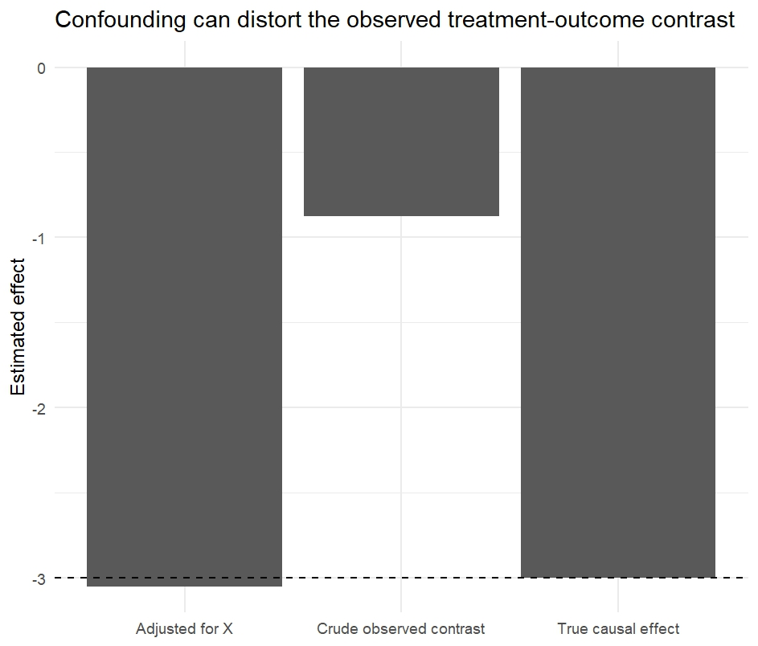

A simulated Experiment
In simulation we can observe both potential outcomes.
We construct a world such that $Y\left(1\right)−Y\left(0\right)=−3.$
X is a common cause of treatment and the outcome.
Crude $E\left(Y | A=1\right)−E(Y|A=0)$ does not give the true causal effect.
Adjustment for the right variable recovers the causal effect.

